Slide 1
GRAPHICAL PASSWORD AUTHENTICATION SYSTEM
NAME:AKSHAYA 7376211AG101
DEVANANDHA 7376211AG107
PRAVEEN KUMAR 7376211AG124
SIVARANJANI 7376211AG129

Slide 2
ABSTRACT :
Commonly textual passwords are the most used form of authentication for all websites and applications .But the main reason behind the development of graphical password is to ensure security.Textual passwords can hacked easily through bruteforcing ,dictionary attack abd fishing whereas in graphical passwords,dictionary attacks and brute force search are infeasible.Adding to that ,graphical passwords are human friendly because they can be easily remembered as users remember image better than words.
So,our idea is , here we develop a web based application that uses graphical application . We are going to use nine images with nine points,one point for single image. While registering the password, the nine images appear in random order presented in a graphical user interface . The user is allowed to click any five images in any specific order of his own.And the images clicked in an specific order is registered as his password .Next time when the user tries to login,he can see those nine images which are shuffled in any order presented in a GUI .So the get successful login using his password, the user needs to click the five images in the same same specific order in which he clicked during his password registration.This is what the idea of graphical password .
Next is the what the technology stack we use for this . The text editor used for this development is sublime text because it is a shareware cross-platform source code editor with a python application programming interface .Since we are going to use javascript for the front end and python for the back end . The server set up is done using XAMPP and SQL which is used to collaborate with the database. It may be utilized for storing,manipulating and retrieving information in database.

Slide 3
PROBLEM STATEMENT :
Passwords are ubiquitous today on any platform,on possible any website. But to remember so difficult passwords and that too on numerous websites seems daunting and therefore you can devise a project illustrating graphical password strategy . This will allow that user to set passwords in the form of graphical presentation in a certain pattern and later use that pattern to login to the system.
Remembering numerous passwords from various different sites can be difficult for a user. So to provide some flexibility we can provide users a graphical password authentication system where instead of creating a password.

Slide 4
PROPOSED SOLUTION TO THE PROBLEM ADDRESSED :
Our idea is , here we develop a web based application that uses graphical application . We are going to use nine images with nine points , one point for single image. While registering the password, the nine images appear in random order presented in a graphical user interface . The user is allowed to click any five images in any specific order of his own . And the images clicked in an specific order is registered as his password .Next time when the user tries to login , he can see those nine images which are shuffled in any order presented in a GUI .So the get successful login using his password, the user needs to click the five images in the same specific order in which he clicked during his password registration . This is what the idea of graphical password .

Slide 5
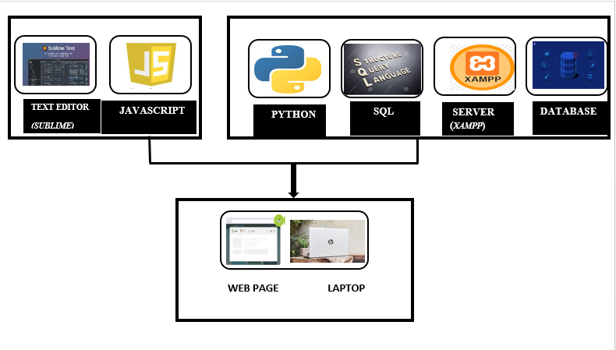
TECHNOLOGY STACK :

Slide 6
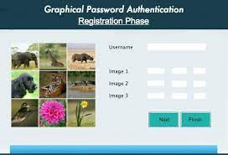


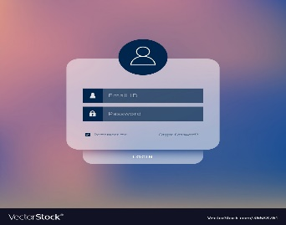

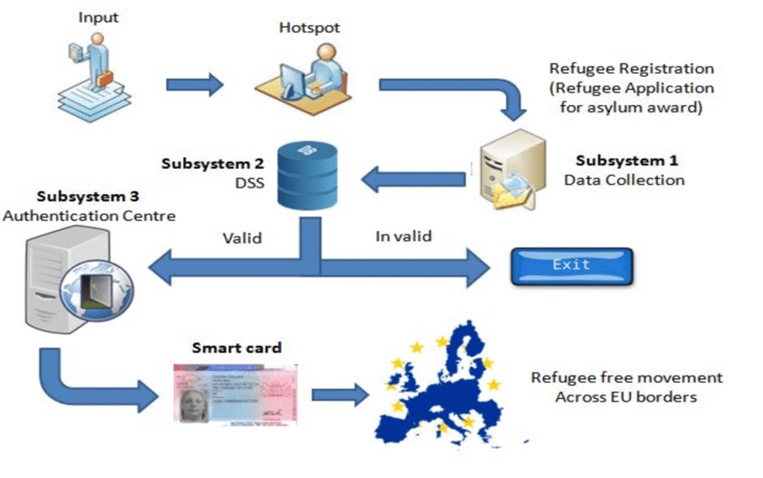

USE CASE
ENROLL AND CREATE PASSWORD (graphical)
LOGIN SUCCESS
LOGIN
SERVER
AUTHENTICATION PROCESS
USER
MOBILE MESSAGE
FAILED
SHOW STOPER
The device must have active internet connection.

